Slide 1
UPGRADE CYCLES & LONG TERM SUPPORT
Ensuring Budget Predictability

Slide 2
TYPO3 CMS
THE IDEAL CMS FOR
STABILITY, DURABILITY,
AND LONG-TERM RELIABILITY
2024
TYPO3 GmbH
Notes:
TYPO3 is a software that adapts to your needs and mirrors the roles in your company from editor to content deliverer to administrator

Slide 3
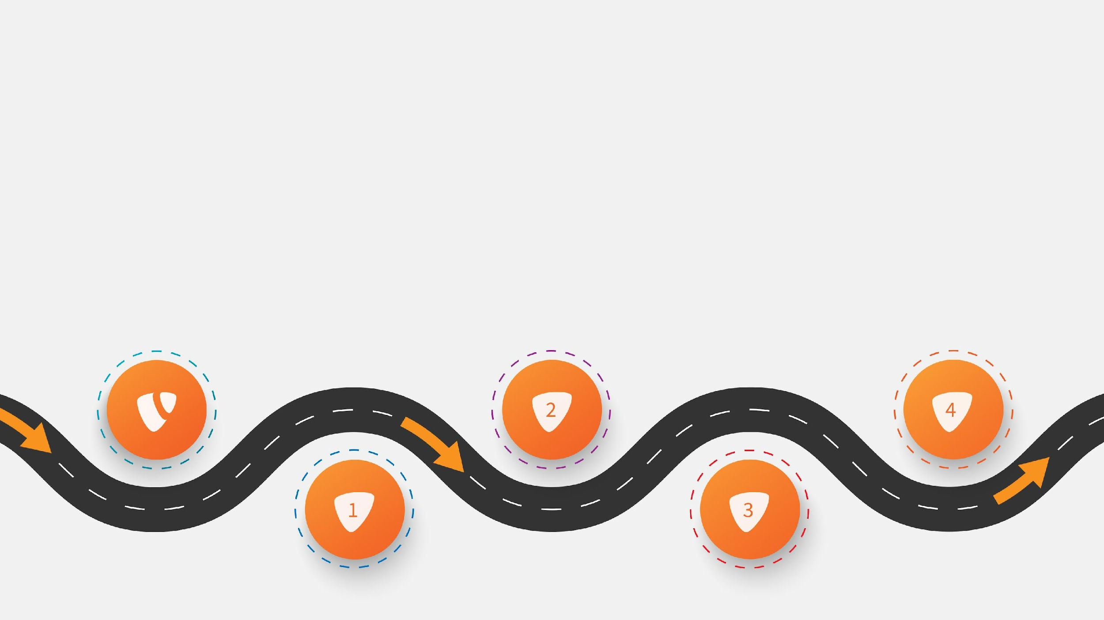
TYPO3 CMS
Be sure to keep rankings, traffic and trust, because of reasons™.
Mitigate risks with TYPO3’s professional Security Team, proactive community, and long-term support.
That’s why your choice of CMS impacts on your security.
2024
TYPO3 GmbH
‹#›

Slide 4
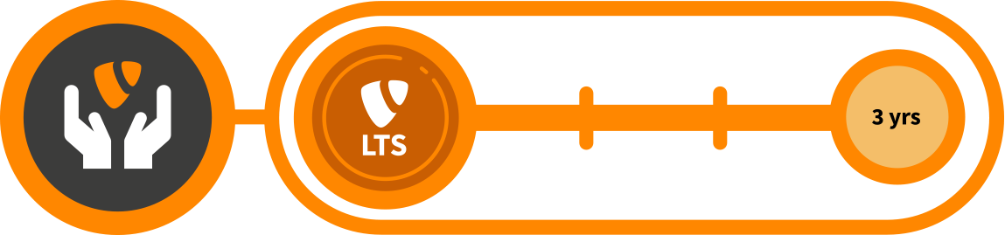
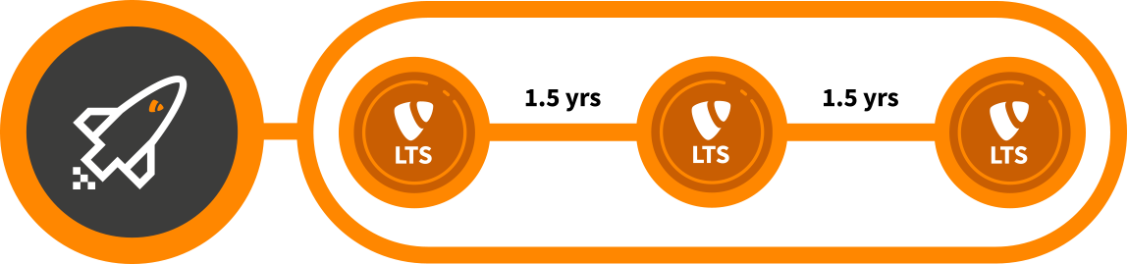

TYPO3 CMS
Predictability & security are the top priorities
Reliable and regular release cycles
TYPO3 LTS versions always offer 3 years of support
New LTS versions are released every 1.5 years
Two major versions are always officially supported at a time
2024
TYPO3 GmbH
‹#›

Slide 5


TYPO3 CMS
UP TO SEVEN YEARS OF
MAINTENANCE AND SUPPORT
Free TYPO3 community support for 3 years
1.5 years full regular maintenance
1.5 years priority bug fixing with security fixes and critical updates
Paid Extended Long-Term Support (ELTS)
available for up to four additional years.*
* 4th year of ELTS only available for TYPO3 Partners
2024
TYPO3 GmbH
‹#›

Slide 6
TYPO3 CMS
Stability with a track-record of proven success
26+ Years of Experience
A resilient organizational structure — a non-profit association, a commercial arm, and a vibrant professional open source community working harmoniously ensure TYPO3’s future.
The TYPO3 Company is the official software vendor and offers products, services, and guarantees for TYPO3 CMS.
Consistent, on-time releases and code quality underscore TYPO3’s predictability and long-term reliability.
2024
TYPO3 GmbH
‹#›

