Slide 1
MULTISITE SOLUTIONS
Global Outreach with global Connections

Slide 2
TYPO3 CMS
BRANDS MANAGE
MULTIPLE WEBSITES FROM
ONE SINGLE PLATFORM
2024
TYPO3 GmbH
Notes:
TYPO3 is a software that adapts to your needs and mirrors the roles in your company from editor to content deliverer to administrator

Slide 3

TYPO3 CMS
Global brand consistency and local flexibility
Are you a global organization with multiple brands, products, regions, departments?
Customize individual brands, regions, departments and franchises while centralizing content control
Photo: iStock.com/Hilch
2024
TYPO3 GmbH
‹#›

Slide 4
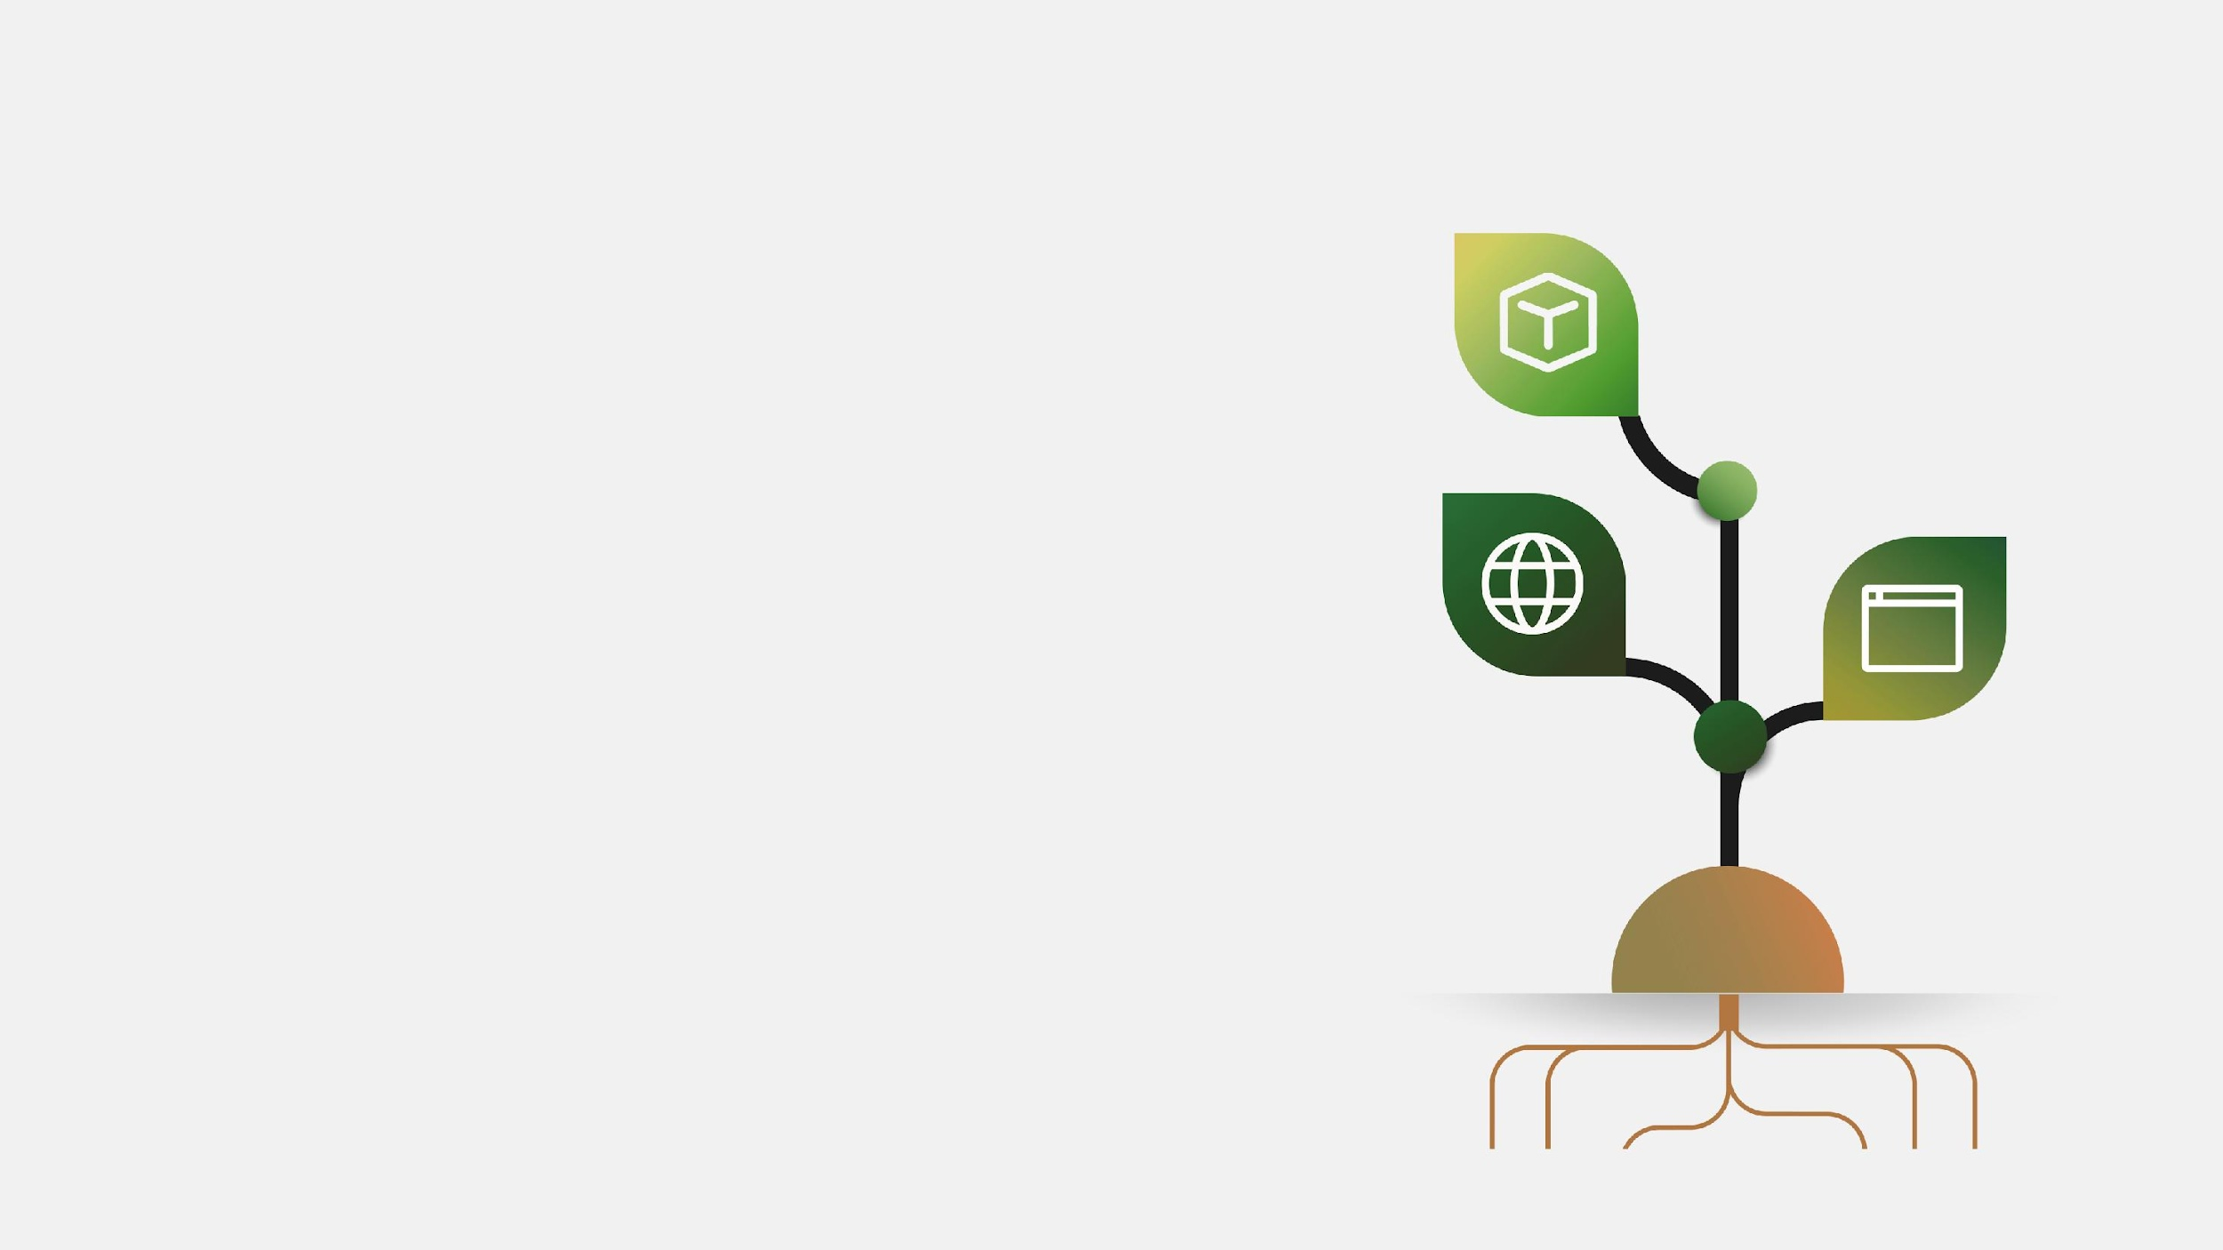
TYPO3 CMS
Scale your brand with ease
Are you growing brands, regions, products, or departments?
Easily add more sites as your organization grows, whether it’s a full-fledged website, microsite or even just a one-pager.
Photo: iStock.com/Papapapong
2024
TYPO3 GmbH
‹#›

Slide 5

TYPO3 CMS
Consistently create content across sites
Do you have the need for content consistency?
Easily use cross-website features such as shared content elements & templates
Photo: iStock.com/Thanakorn Lappattaranan
2024
TYPO3 GmbH
‹#›

Slide 6
TYPO3 CMS
MINIMIZE COSTS
BY PAYING FOR ONLY
ONE INSTALLATION
2024
TYPO3 GmbH
Notes:
TYPO3 is a software that adapts to your needs and mirrors the roles in your company from editor to content deliverer to administrator

Slide 7
TYPO3 CMS
TYPO3 Multisite Key Features
Manage multiple websites from a single platform
Manage multiple sites with a single installation with central content and brand strategy administration and control
Granular user permissions: easily configure editor roles across multiple websites.
Shared content elements: You can create and manage content elements that can be shared across different sites.
Shared templates & features: shared templates for content elements and features/plugins that can be used across different sites.
2024
TYPO3 GmbH

Slide 8
TYPO3 CMS
CASE STUDY
2024
TYPO3 GmbH
Notes:
TYPO3 is a software that adapts to your needs and mirrors the roles in your company from editor to content deliverer to administrator

Slide 9


TYPO3 CMS
Client: steute Technologies
Agency: orangefluid GmbH
Link: typo3.com/customers/case-studies/steute-technologies
Challenge
a collection of websites with different, outdated underlying CMS systems, making content editing time-consuming and incohesive
Slow in terms of editorial work as well as technical optimization
2024
TYPO3 GmbH

