Slide 1
EXTENSIBILITY & FLEXIBILITY
Enterprise. Any Size.

Slide 2
TYPO3 CMS
CUSTOMIZE WITH
LIMITLESS EXTENSIONS
AND SCALE WITH
RELIABLE INTEGRATIONS
2024
TYPO3 GmbH
Notes:
TYPO3 is a software that adapts to your needs and mirrors the roles in your company from editor to content deliverer to administrator

Slide 3

TYPO3 CMS
Expand TYPO3 through seamless integrations
TYPO3 includes many industry-standard features by default, but there may still be occasions, when you wish to expand its functionality further.
PIM | ERP | CRM | Cloud | DAM | Search | E-Commerce | Payment
HR | Marketing | Translation | Authentication | Frontend-Frameworks
TYPO3 easily integrates with other enterprise, marketing, and middleware systems.
2024
TYPO3 GmbH

Slide 4
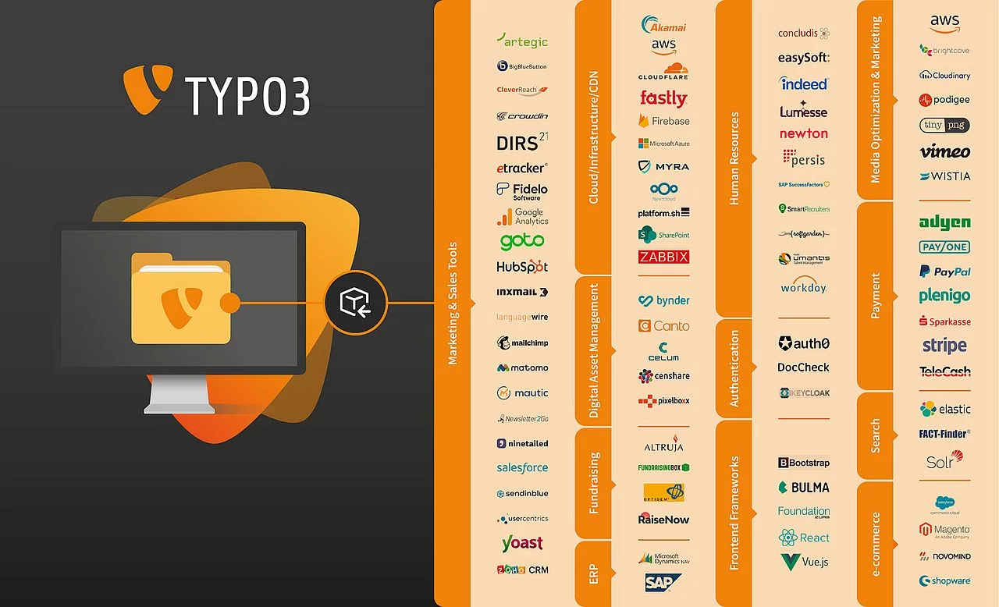
TYPO3 CMS
Structural Flexibility & Open Architecture
Protect your investment and freedom of choice
Sales Tools
Marketing Tools
E-Commerce
Payment Providers
ERP
and many more
2024
TYPO3 GmbH

Slide 5
TYPO3 CMS
Seamless extensibility based on modern standards
Keep your options open
A rich set of third-party extensions meet any business requirements – from small blog to enterprise.
Extend TYPO3 with new functions and find the help you need in a supportive community of professionals.
Built on industry-standard like open source libraries and practices, PSR-compliant implementations, Composer-based dependency management and PHP.
2024
TYPO3 GmbH

Slide 6
TYPO3 CMS
Learn More
About Extensibility with TYPO3
https://typo3.com/typo3-cms/open-extensible-customizable
https://typo3.com/services/trusted-integrations-solutions
https://typo3.com/services/trusted-integrations-solutions/verified-extensions-integrations-for-typo3
https://typo3.com/typo3-cms/why-typo3/typo3-for-marketers
https://typo3.com/blog/typo3-and-sap-customer-data-cloud
2024
TYPO3 GmbH

